Slide 1
Chapter 4
Arithmetic Functions

Slide 2
overview
Iterative combinational circuits
Binary adders
Half and full adders
Ripple carry and carry lookahead adders
Binary subtraction
Binary adder-subtractors
Signed binary numbers
Signed binary addition and subtraction
Overflow
Binary multiplication
Other arithmetic functions
Design by contraction

Slide 3
Iterative Combinational Circuits
Arithmetic blocks
Operate on binary input vectors and produce binary output vectors.
The function implemented often requires the same sub-function be applied to each bit position
A functional block is designed for the sub-function and then used repetitively for each bit position of the overall arithmetic block being designed.
There will often be one or more connections to pass values between adjacent bit positions.
Internal variables are input or outputs of the sub-functions, but are not accessible outside the overall arithmetic block.
The sub-function blocks are referred to as cells and the overall implementation is an array of cells.

Slide 4
Block Diagram of a 1D Iterative Array
Example: Binary addition of two 32 bit integer :
n = 32
Number of inputs = ?
Truth table rows = ?
Equations with up to ? input variables
Equations with huge number of terms
Design impractical!
Iterative array takes advantage of the regularity to make design feasible
Due to the repetitive nature of the circuit and the association of a vector index with each of the circuit cells , the overall functional block is referred as an iterative array.

Slide 5
Functional Blocks: Addition
Addition Development:
Half-Adder (HA), a 2-input bit-wise addition functional block,
Full-Adder (FA), a 3-input bit-wise addition functional block,
Ripple Carry Adder, an iterative array to perform binary addition, and
Carry-Look-Ahead Adder (CLA), a hierarchical structure to improve performance.

Slide 6
Functional Block: Half-Adder
A 2-input, 1-bit width binary adder that performs the following computations:
A half adder adds two bits to produce a two-bit sum and carry.
The sum is expressed as a sum bit S and a carry bit C
The half adder can be specified as a truth table for S and C ⇒
X
0
0
1
1
+ Y
+ 0
+ 1
+ 0
+ 1
C S
0 0
0 1
0 1
1 0
X
Y
C
S
0
0
0
0
0
1
0
1
1
0
0
1
1
1
1
0

Slide 7
Logic Simplification: Half-Adder
The K-Map for S, C is:
This is a pretty trivial map! By inspection:
and
These equations lead to several implementations.
S
Y
Y
C
Y
Y
X
1
X
0
1
0
1
X
1
X
1
=
+
=
⊕
2
3
2
3
S
X
Y
X
Y
X
Y
X
S
Y
C
=
⋅
X
Y
C

Slide 8
Functional Block: Full-Adder
A full adder is similar to a half adder, but includes a carry-in bit from lower stages. Like the half-adder, it computes a sum bit, S and a carry bit, C.
For a carry-in (Z) of 0, it is the same as the half-adder:
For a carry- in (Z) of 1:
Z
0
0
0
0
X
0
0
1
1
+ Y
+ 0
+ 1
+ 0
+ 1
C S
0
0
0 1
0 1
1 0
Z
1
1
1
1
X
0
0
1
1
+ Y
+ 0
+ 1
+ 0
+ 1
C S
0 1
1 0
1 0
1
1

Slide 9
Logic Optimization: Full-Adder
Full-Adder K-Map:
X
Y
Z
C
S
S
Y
Z
Y
Z
Y
Z
Y
Z
C
Y
Z
Y
Z
Y
Z
Y
Z
0
0
0
0
0
X
1
1
X
1
0
0
1
0
1
0
1
3
2
0
1
3
2
0
1
0
0
1
X
1
1
X
1
1
1
4
5
7
6
4
5
7
6
0
1
1
1
0
1
0
0
0
1
1
0
1
1
0
S
=
X
Y
Z
+
X
Y
Z
+
X
Y
Z
+
X
Y
Z
1
1
0
1
0
C
=
X
Y
+
X
Z
+
Y
Z
1
1
1
1
1

Slide 10
Equations: Full-Adder
S
=
X
Y
Z
+
X
Y
Z
+
X
Y
Z
+
X
Y
Z
C
=
X
Y
+
X
Z
+
Y
Z
The S function is the three-bit XOR function (Odd Function):
The Carry bit C is 1 if both X and Y are 1 (the sum is 2), or if the sum is 1 and a carry-in (Z) occurs. Thus C can be re-written as:
The term X·Y is carry generate.
The term X⊕Y is carry propagate.
S
=
X
⊕
Y
⊕
Z
C
=
X
Y
+
(
X
⊕
Y
)
Z

Slide 11
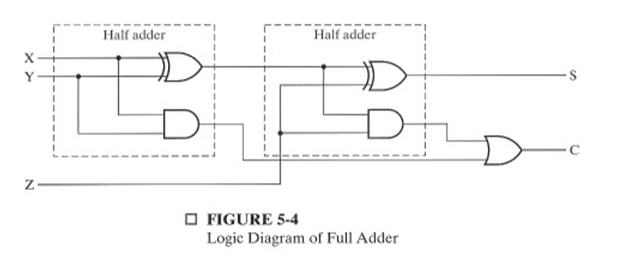
Implementation : FULL ADDER
Full Adder Schematic
S
=
X
⊕
Y
⊕
Z
C
=
X
Y
+
(
X
⊕
Y
)
Z

Slide 12
4-bit Ripple-Carry Binary Adder
A four-bit Ripple Carry Adder made from four 1-bit Full Adders:
Description
Subscript
Name
3 2 1 0
Carry In
0 1 1 0
Ci
Augend
1 0 1 1
Ai
Addend
0 0 1 1
Bi
Sum
1 1 1 0
Si
Example: 4-bit ripple carry adder: Adds input vectors A(3:0) and B(3:0) to get a sum vector S(3:0)
Note: carry out of cell I becomes carry in of cell i + 1
Carry out
0 0 1 1
Ci+1

Slide 13

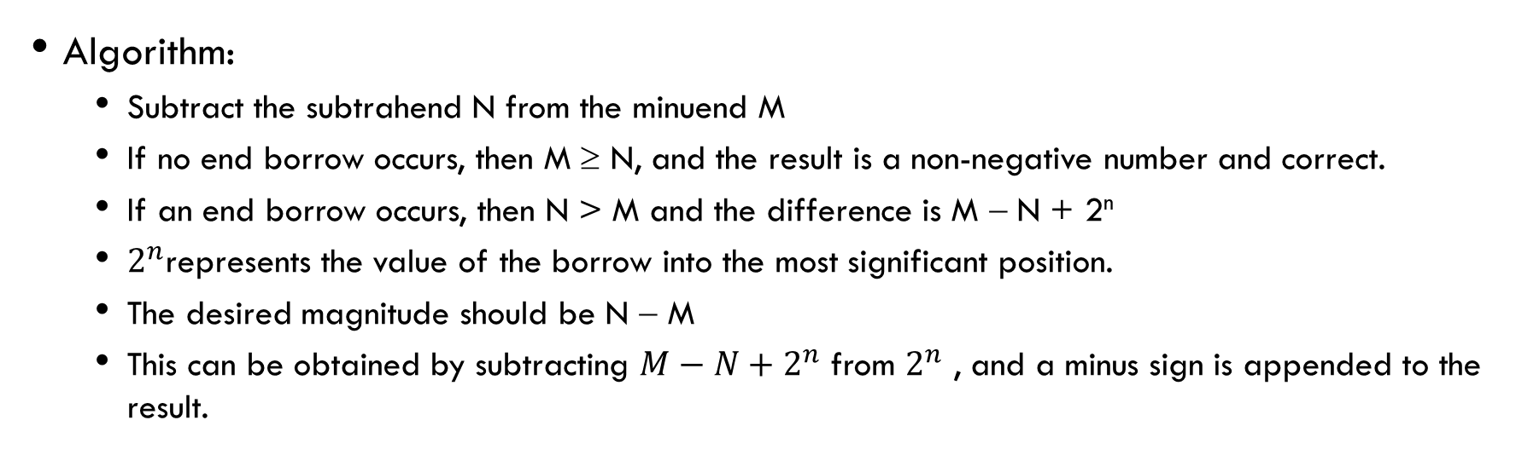
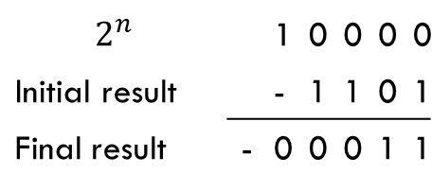

Unsigned Subtraction
Algorithm:
Subtract the subtrahend N from the minuend M
If no end borrow occurs, then M ≥ N, and the result is a non-negative number and correct.
If an end borrow occurs, then N > M and the difference is M − N + 2^{n}
$2^{n}$represents the value of the borrow into the most significant position.
The desired magnitude should be N − M
This can be obtained by subtracting $M−N+2^{n}$ from $2^{n}$ , and a minus sign is appended to the result.
Correction
Borrows into | 0 | 1 | 1
Minuend(M) |  | 1 | 0 | 0 | 1
Subtrahend (N) | - | 0 | 1 | 1 | 1
Difference |  | 0 | 0 | 1 | 0
Borrows into | 1 | 1 | 1 | 1
Minuend(M) |  | 0 | 1 | 0 | 0
Subtrahend (N) | - | 0 | 1 | 1 | 1
Difference |  | 1 | 1 | 0 | 1
$$2^{n} −\left(M−N+2^{n}\right)=N−M$$
$$2^{n}$$ |  | 1 | 0 | 0 | 0 | 0
Initial result |  | - | 1 | 1 | 0 | 1
Final result | - | 0 | 0 | 0 | 1 | 1
$$(M−N+2^{n})$$

Slide 14
Unsigned Subtraction (continued)
The subtraction, 2^{n} − N, is taking the 2’s complement of N
To do both unsigned addition and unsigned subtraction requires:
Quite complex!
Goal: Shared simpler logic for both addition and subtraction
Introduce complements as an approach

Slide 15
Complements
There are 2 types of complement for each base – r system.
Diminished Radix Complement
(r − 1)’s complement for radix r
1’s complement for radix 2, 9’s compliment for radix 10
Defined as (r^{n} − 1) − Ν (For a given number N in base-r with n digits)
Radix Complement
r’s complement for radix r
2’s complement in binary, 10’s compliment in decimal.
Defined as r^{n} - N ((For a given number N in base-r with n digits)

Slide 16
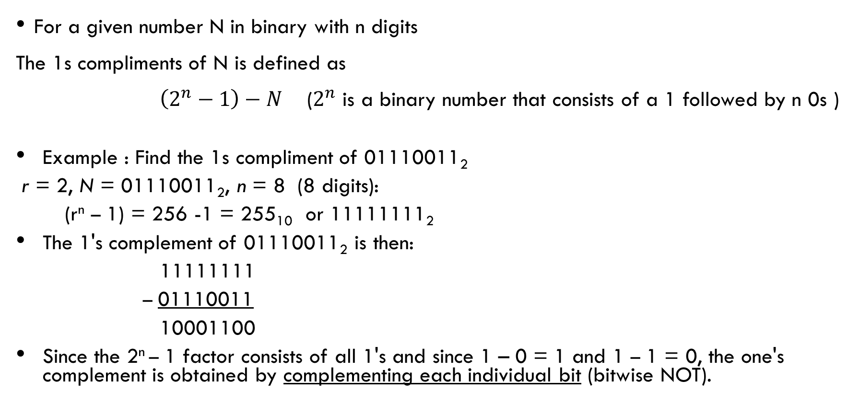
Binary 1's Complement
For a given number N in binary with n digits
The 1s compliments of N is defined as
$\left(2^{n}−1\right)−N$ ($2^{n}$ is a binary number that consists of a 1 followed by n 0s )
Example : Find the 1s compliment of 01110011₂
r = 2, N = 01110011₂, n = 8 (8 digits):
(r^{n} – 1) = 256 -1 = 255₁₀ or 11111111₂
The 1's complement of 01110011₂ is then:
11111111
– 01110011
10001100
Since the 2^{n} – 1 factor consists of all 1's and since 1 – 0 = 1 and 1 – 1 = 0, the one's complement is obtained by complementing each individual bit (bitwise NOT).

Slide 17
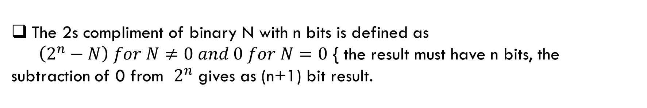
Binary 2's Complement
The 2s compliment of binary N with n bits is defined as
$\left(2^{n}−N\right) for N≠0 and 0 for N=0$ { the result must have n bits, the subtraction of 0 from $2^{n}$ gives as (n+1) bit result.
Example : Find the 2s compliment of 01110011₂
For r = 2, N = 01110011₂, n = 8 (8 digits), we have:
(r^{n} ) = 256₁₀ or 100000000₂
The 2's complement of 01110011 is then:
100000000 – 01110011 10001101
Note the result is the 1's complement plus 1, a fact that can be used in designing hardware
Bit-wise complement first, then add 1

Slide 18
Subtraction with 2’s Complement-unsigned
For n-digit, unsigned numbers M and N, find M − N in base 2:
Add the 2's complement of the subtrahend N to the minuend M: M + (2^{n} − N) = M − N + 2^{n}
If M > N, the sum produces end carry r^{n} which is discarded; from above, M − N remains.
If M < N, the sum does not produce an end carry and, from above, is equal to 2^{n} − ( N − M ), the 2's complement of ( N − M ).
To obtain the result − (N – M) , take the 2's complement of the sum and place a − to its left.

Slide 19
Unsigned 2’s Complement Subtraction Example 1
Find 01010100₂ – 01000011₂
Step 1: Find 2s compliment of the subtrahend
Step 2: Add the 2s compliment of the subtrahend with the minuend
Check carry; if 1 no correction needed , if 0 correction is required
Step 1:2s compliment of 01000011
Bit wise compliment | 10111100
Add 1 | 10111100 + 1
 | 10111101
Step 2
Borrow into | 111111
 | 01010100
 | +10111101
 | 00010001
The carry of 1 indicates that no correction of the result is required and discard the carry.
Result = 00010001

Slide 20
Unsigned 2’s Complement Subtraction Example 2
Find 01000011₂ – 01010100₂
01000011
Step 1:2s compliment of 01010100
Bit wise compliment | 10101011
Add 1 | 10101011 + 1
 | 10101100
Step 2
Borrow into | 011111
 | 01000011
 | +10101100
 | 11101111
The carry of 0 indicates that a correction of the result is required
Correction: 2s compliment of the sum result in step 2 (11101111)
Bit wise compliment | 00010000
Add 1 | 00010000 + 1
 | 00010001
Result = – (00010001)

Slide 21

2’s Complement Adder/Subtractor
Subtraction can be done by addition of the 2's Complement.
1. Complement each bit (1's Complement.)
2. Add 1 to the result.
The circuit shown computes A + B and A – B:
For S = 1, subtract, the 2’s complement of B is formed by using XORs to form the 1’s comp $(B⊕1=\overline{B})$ and adding the 1 applied to C₀.
For S = 0, add, B is passed through unchanged $(B⊕0=B)$

Slide 22
Signed Integers
Positive numbers and zero can be represented by unsigned n-digit, radix r numbers. We need a representation for negative numbers.
To represent a sign (+ or –) we need exactly one more bit of information (1 binary digit gives 2¹ = 2 elements which is exactly what is needed).
Since computers use binary numbers, by convention, the most significant bit is interpreted as a sign bit:
s a_{n–2} … a₂a₁a₀ where: s = 0 for Positive numbers s = 1 for Negative numbers and a_{i} = 0 or 1 represent the magnitude in some form.

Slide 23
Signed Integer Representations
Signed-Magnitude : here the n – 1 digits are interpreted as a positive magnitude.
Signed-Complement : here the digits are interpreted as the rest of the complement of the number. There are two possibilities here:
Signed 1's Complement
Uses 1's Complement Arithmetic
Signed 2's Complement
Uses 2's Complement Arithmetic

Slide 24
Signed Integer Representation Example
r =2, n=3
Number
Sign
-
Mag.
1's Comp.
2's Comp.
+3
011
011
011
+2
010
010
010
+1
001
001
001
+0
000
000
000
–
0
100
111
—
–
1
101
110
111
–
2
110
101
110
–
3
111
100
101

Slide 25
Addition and Subtraction in Signed magnitude system
The addition of two numbers M+N, follows the rules of ordinary arithmetic
If the sign are same, add the two magnitudes and give the sum the sign of M
If the signs are different, subtract the magnitude of N from magnitude of M.
An end borrow determines the sign of the result. And whether a correction is required.
Example 1: 001101 + 000110
Example 2: 0 0011001 + 1 0100101
11 1
0 0011001
1 0100101
1110100
Borrow of 1 indicates M<N
So the sign will be opposite of M , a minus. Also the magnitude 1110100 needs to be corrected by taking 2s compliment .
0 01101
0 00110
0 10011
After correction the result is 1 0001100

Slide 26
Signed-Complement Arithmetic
Addition:
Negative number is represented as 2s compliment form.
Add the numbers including the sign bits, discarding a carry of 1 out of the sign bits (positive number). The negative results are in 2s compliment form (carry 0).
Convert the negative number to signed magnitude form (by taking 2s compliment).
Subtraction
Take the 2s compliment of the subtrahend (including sign bit)
Add it to the minuend (including sign bit)
A carry out of the sign bit is discarded

Slide 27
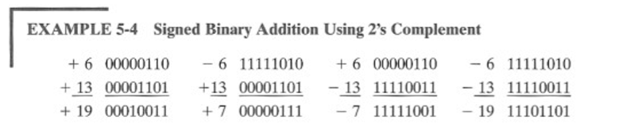
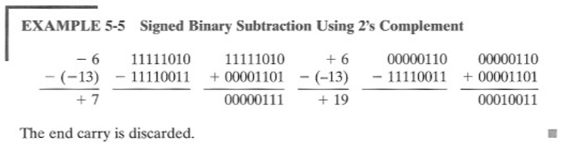
Signed 2’s Complement Examples

Slide 28
Overflow
The result should have sufficient number of bits to accommodate the sum.
Sum of two n bit number may occupy n+1 bits, that is an overflow.
Overflow is a problem in computers because the number of bits that hold a number is fixed, and a result that exceeds the number of bits cannot be accommodated.
Computers detects and can signal the occurrence of an overflow.
For unsigned numbers addition , an overflow is detected from the end carry out of the most significant position.
For signed number , an overflow is detected by observing the carry into the sign bit and the carry out of the signed bit, if these two carries are not equal an overflow has occurred.

Slide 29
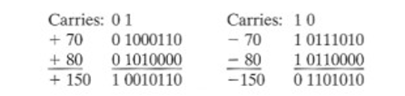
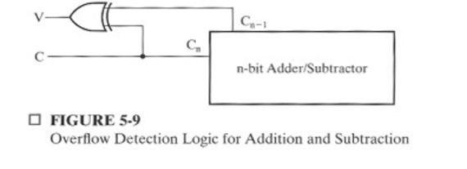
Overflow (Example)

Slide 30
Other Arithmetic Functions
Convenient to design the functional blocks by contraction - removal of redundancy from circuit to which input fixing has been applied
Functions
Incrementing
Decrementing
Multiplication by Constant
Division by Constant
Zero Fill and Extension

Slide 31
Design by Contraction
Contraction is a technique for simplifying the logic in a functional block to implement a different function
The new function must be realizable from the original function by applying rudimentary functions to its inputs
The goal of the contraction is to accomplish the design of a logic circuit or functional block by result from past design.

Slide 32
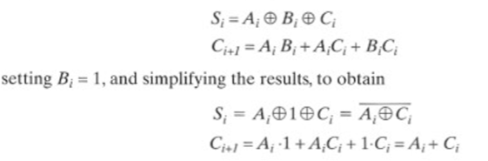
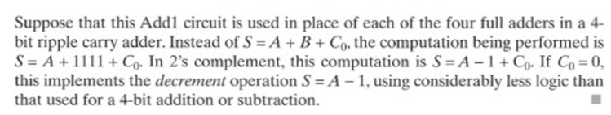
Contraction of Full adder equation

Slide 33
Design by Contraction Example
Contraction can applied to equations or directly on circuit diagram with rudimentary functions applied to function-block inputs
Set B = 001

Slide 34
Incrementing & Decrementing
Incrementing
Adding a fixed value to an arithmetic variable
Fixed value is often 1, called counting (up)
Examples: A + 1, B + 4
Functional block is called incrementer
Decrementing
Subtracting a fixed value from an arithmetic variable
Fixed value is often 1, called counting (down)
Examples: A − 1, B − 4
Functional block is called decrementer

Slide 35
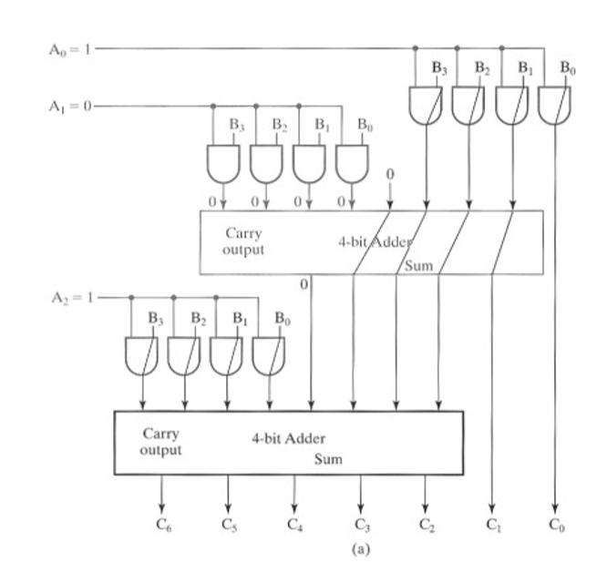
Multiplication by constants

Slide 36
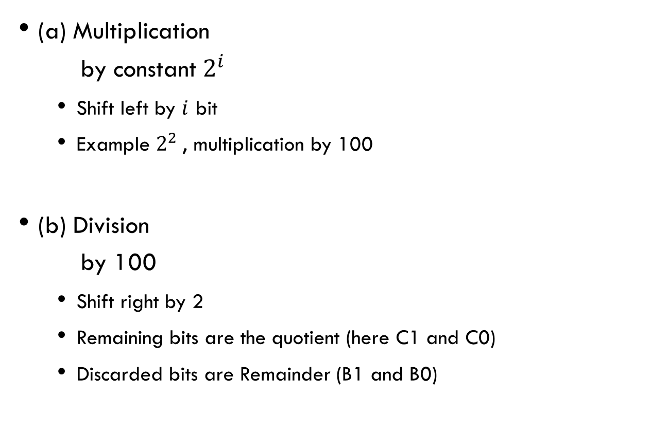
Multiplication/Division by 2n
B
3
B
2
B
1
B
0
(a) Multiplication by constant $2^{i}$
Shift left by $i$ bit
Example $2^{2}$, multiplication by 100
(b) Division by 100
Shift right by 2
Remaining bits are the quotient (here C1 and C0)
Discarded bits are Remainder (B1 and B0)
0
0
C
5
C
4
C
3
C
2
C
1
C
0
B
3
B
2
B
1
B
0
0
0
C
3
C
2
C
1
C
0
C
2
1
C
2
2
(b)

Slide 37
Zero Fill
Zero fill - filling an m-bit operand with 0s to become an n-bit operand
Filling usually is applied to the MSB end of the operand, but can also be done on the LSB end
Example: 11110101 filled to 16 bits
MSB end: 0000000011110101
LSB end: 1111010100000000

Slide 38
Extension
Extension - increase in the number of bits at the MSB end of an operand by using a complement representation
Copies the MSB of the operand into the new positions
Positive operand example - 01110101 extended to 16 bits: 0000000001110101
Negative operand example - 11110101 extended to 16 bits: 1111111111110101

